Slide 1
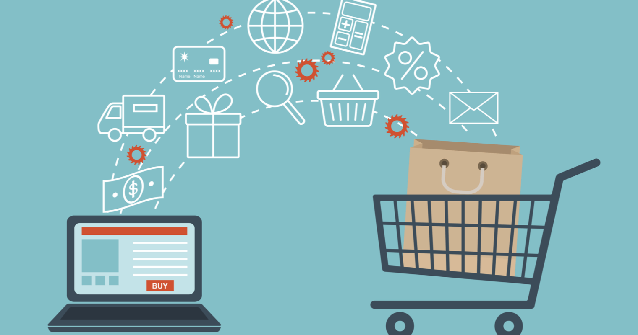

INTRODUCTION TO FIREWALL & CYBERSECURITY
~NIKHIL KHANTWAL

Slide 2
Agenda
1
2
3
4
5
INTRODUCTION
TO FIREWALL & CYBERSECURITY
HISTORY & TYPES OF FIREWALLS
FEATURES & IMPORTANCE OF FIREWALLS
ADVANTAGES & DIS-ADVANTAGES OF FIREWALLS
FUNCTIONS OF FIREWALLS

Slide 3
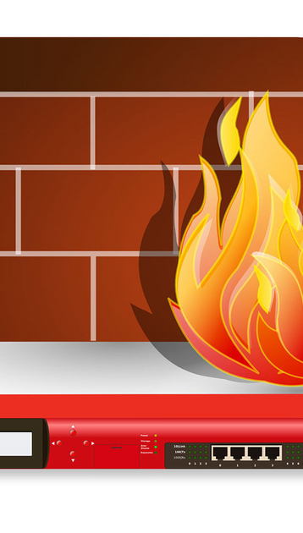
Introduction
A Firewall is a network security device that monitors and filters incoming and outgoing network traffic based on an organization’s previously established security policies. At its most basic, a firewall is essentially the barrier that sits between a private internal network and the public Internet. A firewall’s main purpose is to allow non-threatening traffic in and to keep dangerous traffic out.
a part of a computer system that is designed to prevent people from getting information without authority but still allows them to receive information that is sent to them
This Photo by Unknown Author is licensed under CC BY-SA

Slide 4

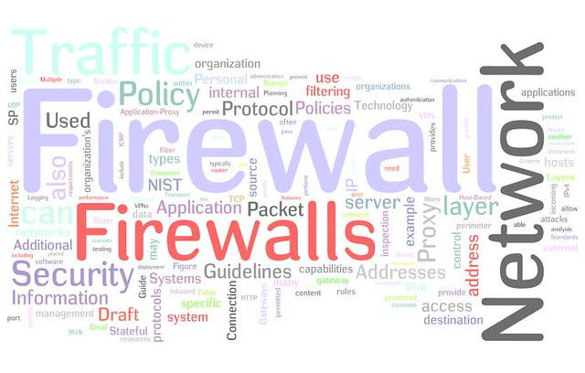
HISTORY & NEED FOR FIREWALLS: 1} Firewalls have existed since the late 1980’s and started out as packet filters, which were networks set up to examine packets, or bytes, transferred between computers. Though packet filtering firewalls are still in use today, firewalls have come a long way as technology has developed throughout the decades. 2}Back in 1993, Check Point CEO Gil Shwed introduced the first stateful inspection firewall, FireWall-1. Fast forward twenty-seven years, and a firewall is still an organization’s first line of defence against cyber attacks. Today’s firewalls, including Next Generation Firewalls and Network Firewalls support a wide variety of functions and capabilities with built-in features.
This Photo by Unknown Author is licensed under CC BY

Slide 5

FIREWALL HISTORY
Gen 1 Virus:
Gen 2 Virus:
Gen 3 Virus:
Generation 3, Early 2000’s, exploiting vulnerabilities in applications which affected most businesses and drove Intrusion Prevention Systems Products (IPS).
Gen 1 Virus
Generation 1, Late 1980’s, virus attacks on stand-alone PC’s affected all businesses and drove anti-virus products.
Gen 2 Networks
Generation 2, Mid 1990’s, attacks from the internet affected all business and drove creation of the firewall.

Slide 6

HISTORY OF FIREWALLS
Gen 4 Payload:
Gen 5 Mega:
Generation 4, Approx. 2010, rise of targeted, unknown, evasive, polymorphic attacks which affected most businesses and drove anti-bot and sandboxing products.
Generation 5, Approx. 2017, large scale, multi-vector, mega attacks using advance attack tools and is driving advance threat prevention solutions.

Slide 7

TYPES OF FIREWALLS
1
2
3
4
5
Packet filtering
Proxy Service
Stateful inspection
Next Generation Firewall (NGFW)
Network Based Firewalls

Slide 8
REAL TIME APPLICATIONS OF A FIREWALL
1. PREVENTING UNAUTHORIZED ACCESS TO RESOURCES:
PREVENTING COMMAND AND CONTROL TRAFFIC:
One of the core applications of a firewall is to control access to resources on a network and prevent unauthorized access to those resources.
For example, let’s say we deployed a file share server that allows employees to store and access files centrally instead of keeping local copies on their devices. Anyone who is not an employee, however, should not be able to access this file share.
When attackers gain unauthorized access to a network, they will sometimes install malware that enables them to remotely send the computer commands. Large groups of these infected computers are often referred to as “botnets.” Using threat intelligence such as the IP addresses of known command and control infrastructure, the network traffic can be denied by the firewall before it ever establishes a connection.

Slide 9
SOME MORE APPLICATIONS OF A FIREWALL
PREVENTING NETWORK DATA LOSS:
IDENTIFYING NETWORK INTRUSION ATTEMPTS:
Similar to inspecting network traffic for known malicious websites, we can inspect network traffic for sensitive data such as credit card information, personally identifiable information or trade secrets. If this data is detected in the traffic, we can choose to allow or deny it based on various parameters, such as the destination site.
Most modern firewalls also include built-in intrusion detection and/or prevention systems. These tools analyse the network traffic reaching the firewall to detect malicious traffic that is likely to originate from an attacker. If this traffic is detected, an alert will be raised for investigation and, in some instances, blocked.

Slide 10

HOW TO USE FIREWALL SECURITY: 1} Secure the Firewall. 2} Establish Firewall Zones and an IP Address Structure. 3} Configure Access Control Lists (ACLs) . 4} Configure Other Firewall Services and Logging. 5} Test the Firewall Configuration. 6} Manage Firewall Continually.

Slide 11
ADVANTAGES OF A FIREWALL
Monitors Network Traffic:
Stops Virus Attacks:
Prevents Hacking &Promotes Privacy:
All of the benefits of firewall security start with the ability to monitor network traffic. Data coming in and out of your systems creates opportunities for threats to compromise your operations. By monitoring and analyzing network traffic, firewalls leverage preestablished rules and filters to keep your systems protected.
Nothing can shut your digital operations down faster and harder than a virus attack. With hundreds of thousands of new threats developed every single day, it is vital that you put the defenses in place to keep your systems healthy.
Firewall prevent from hacking &An overarching benefit is the promotion of privacy. By proactively working to keep your data and your customers' data safe, you build an environment of privacy that your clients can trust.

Slide 12
DISADVANTAGES OF A FIREWALL
Application Awareness Limitations:
Issues with Network Speed:
Logistical Drawbacks:
Many traditional firewalls are not capable of adapting to the changing aspect of company systems and operations. They can be clunky, require extensive management and maintenance, and struggle to adapt to cloud-based environments.
Traditional firewalls lack the ability to go as deep as NGFWs, especially when it comes to applications. NGFWs allow the user to see which applications are being used across the network and enable the ability to control specific usage within those applications. With a traditional firewall, the flexibility to control access this deep is not available.
Speed is an issue. Many traditional firewalls create a bottleneck at the data inspection points, which can slow down your operation and cost you money. For operations expecting to scale, add more rules, policies, and security protocols, this is not ideal.

Slide 13
CONCLUSION
Final Remarks:
Summary:
Conclusion:
A firewall can improve privacy by blocking access to services and the Domain Name Service in addition to lowering risks to the internal network.
A firewall is a network security device that monitors incoming and outgoing network traffic and decides whether to allow or block specific traffic based on a defined set of security rules
A firewall is the most important aspect of overall security, since it enforces authentication upon all users, and all inbound and outbound traffic is monitored. This module has discussed the types of firewalls, as well as the protocols, gateways, and devices used to increase security at the network level.

Slide 14
THANKYOU FOR BEING A PATIENT LISTENER.
“
”
~NIKHIL KHANTWAL

Slide 15
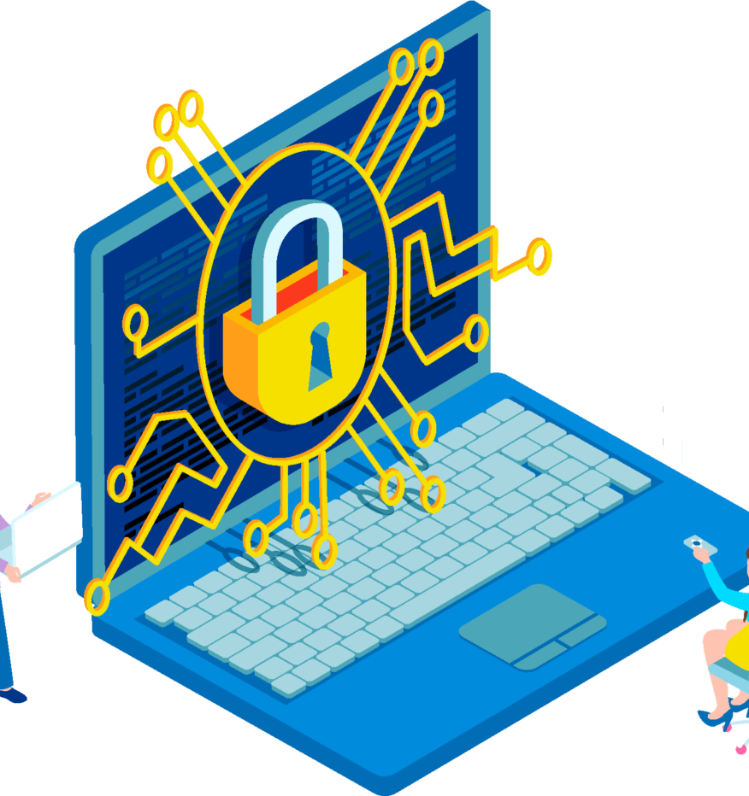
Thank you
~NIKHIL KHANTWAL
This Photo by Unknown Author is licensed under CC BY-NC

